Slide 1
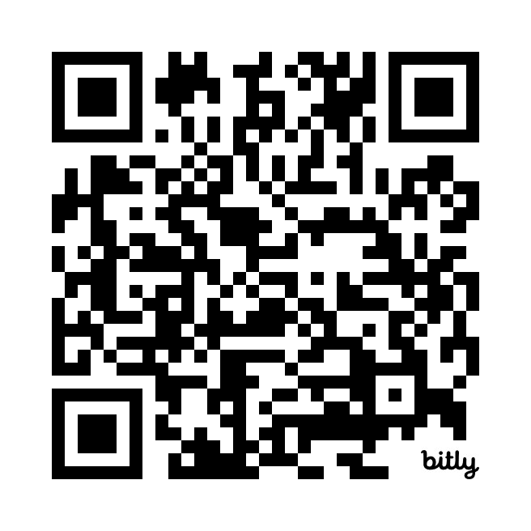
Software Requirements Quiz
https://bit.ly/3VvyZI4

